Slide 1
Experiments With Qualtrics And Amazon Mechanical Turk
Leo Goldman
leo.goldman@columbia.edu
Columbia Experimental Lab For Social Sciences
https://celss.iserp.columbia.edu/
Last Update: November 2019

Slide 2
Today’s Goals
Learn about Qualtrics and Mechanical Turk (MTurk)
Understand their pros/cons
Learn how to use both
Establish a fundamental understanding so that building your experiment is the easy part

Slide 3
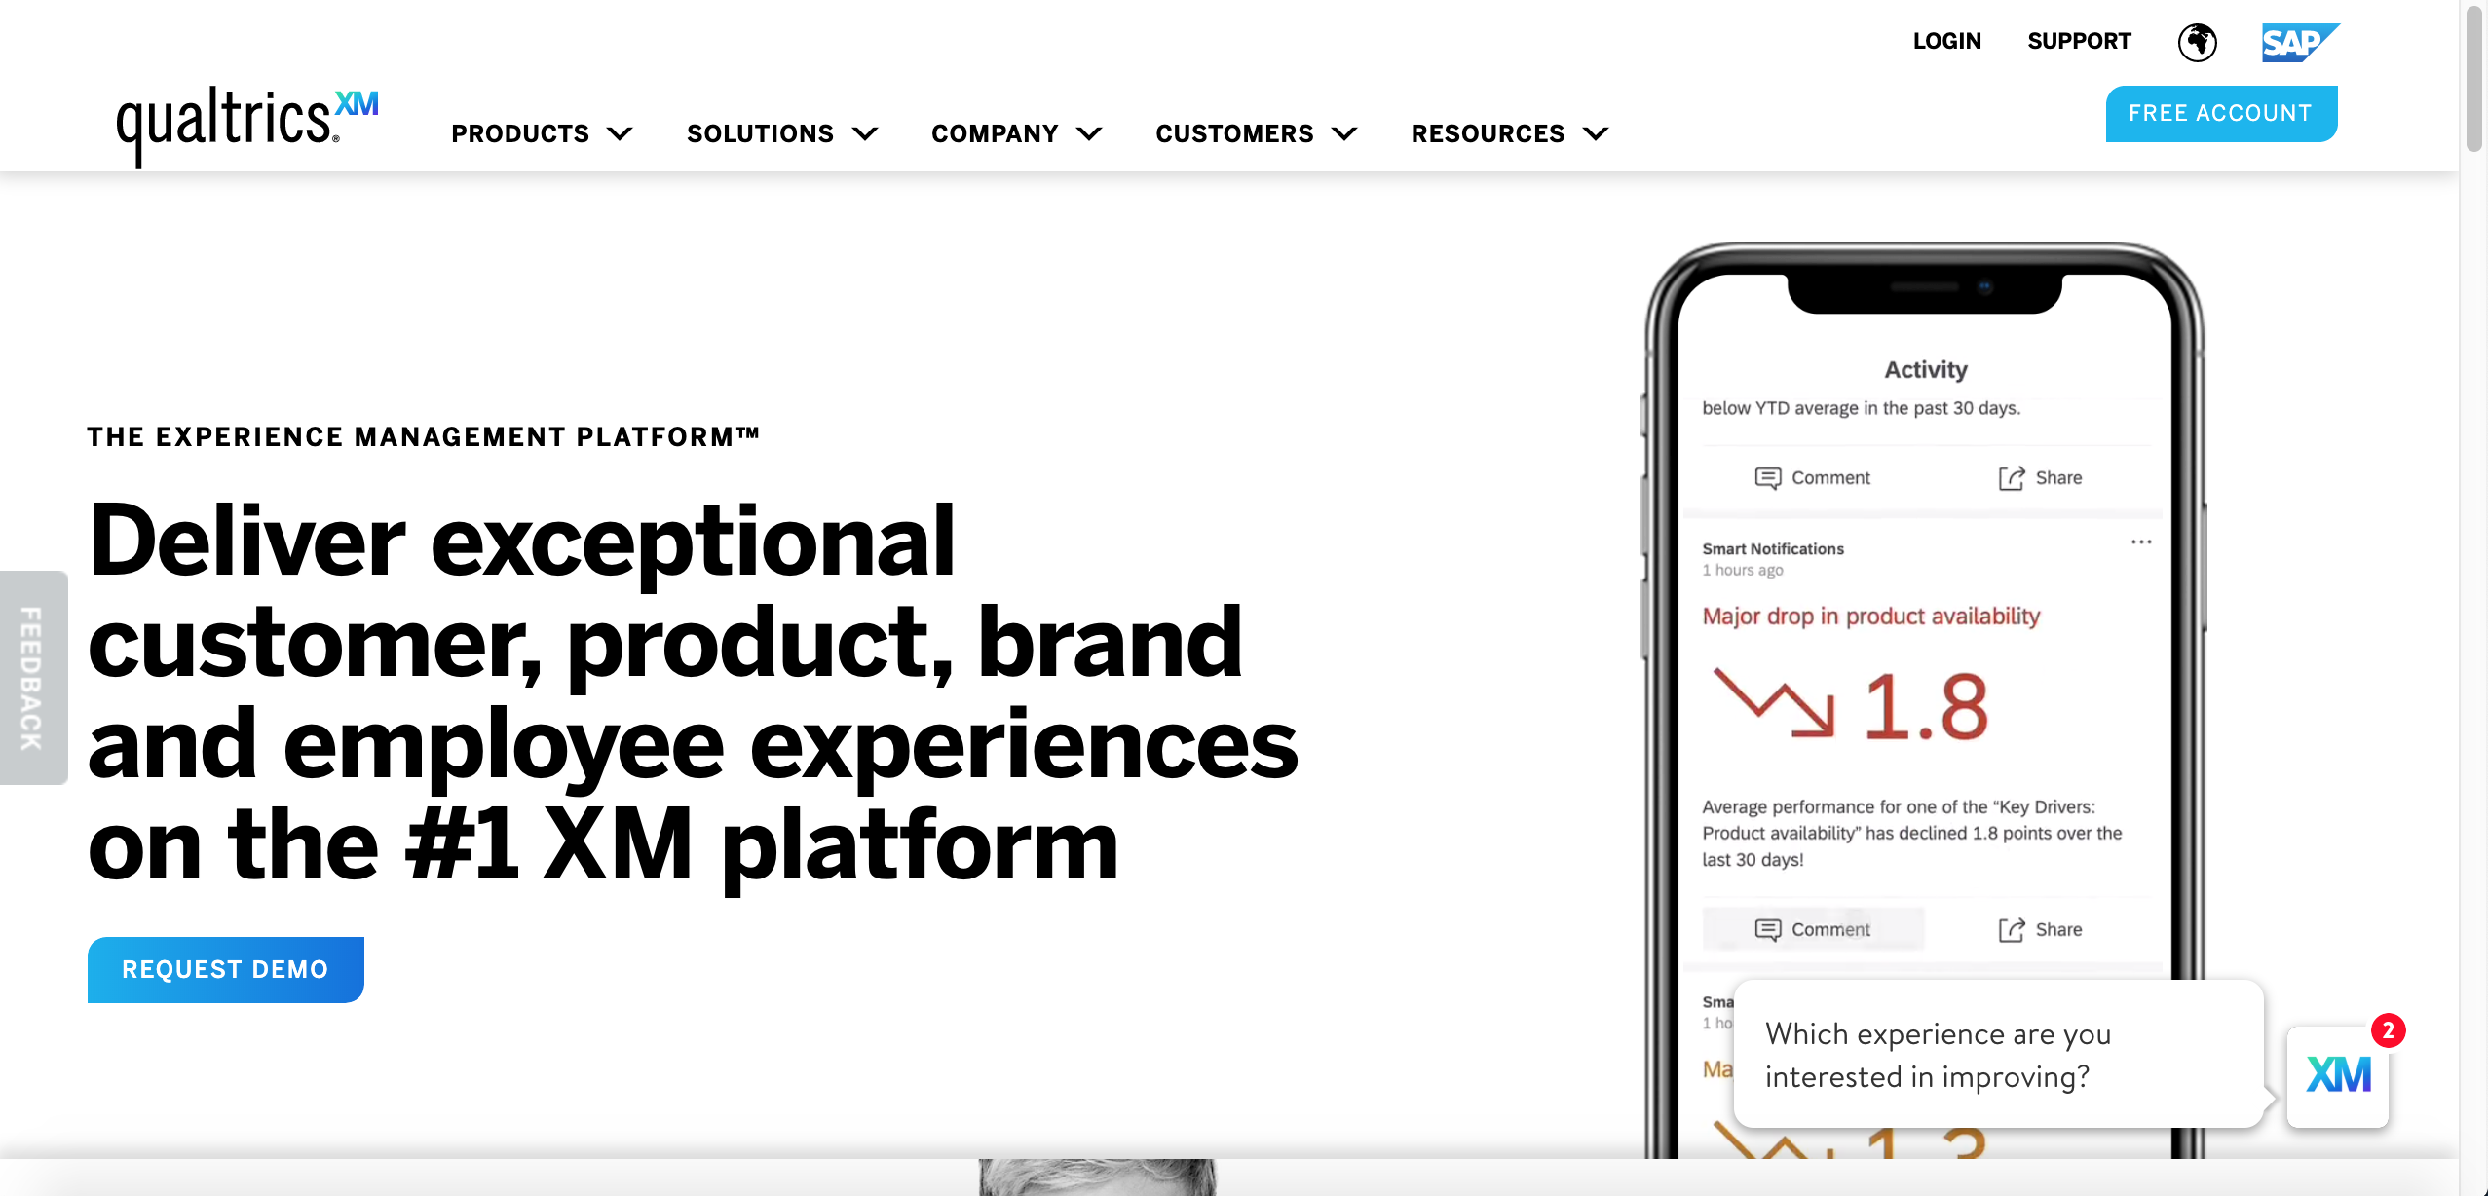
Qualtrics – What is It?
https://www.qualtrics.com/

Slide 4
Qualtrics – What is It?
Survey Tool
More features/customizable than Survey Monkey, Google Forms
Timing Questions/Clicks
Embedded/Piped Data
Dynamic (Randomization, JavaScript)
Available through CELSS*
Licenses (beyond free accounts) start at ~$3,000/year
*Not yet finalized. CELSS plans to make accounts available to researchers with planned projects by 2020

Slide 5
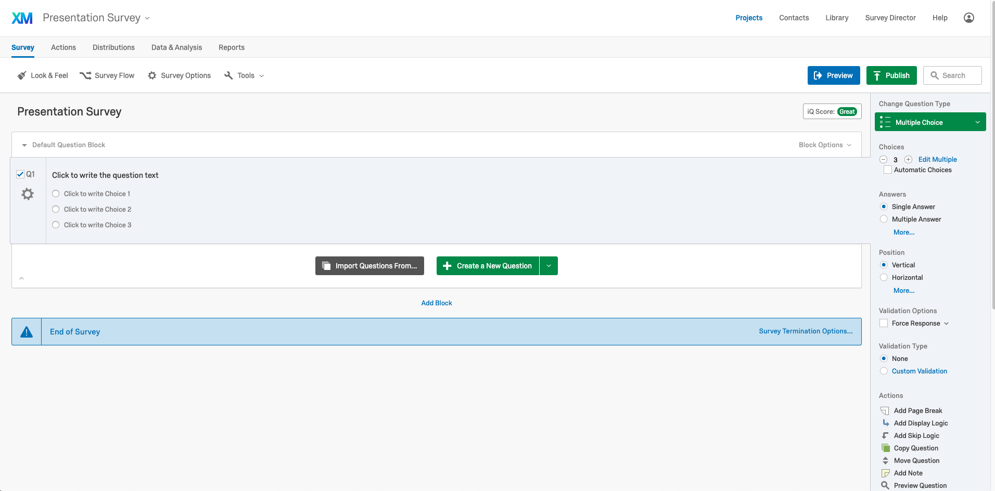
Qualtrics – What is It?

Slide 6
Qualtrics - Vocabulary
Question
A single question: multiple-choice, text, description, etc.
Question Block or just “Block”
A group of questions that are presented/moved/copied as a unit
Survey Flow
Overall survey map
Main tool for structuring/organizing

Slide 7
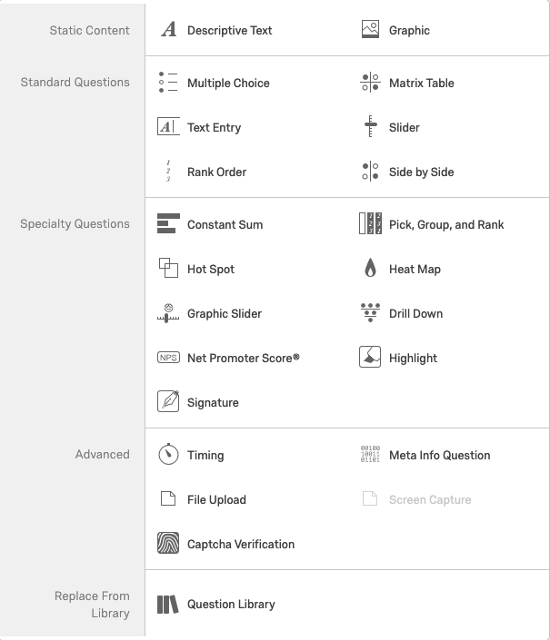
Qualtrics – Question Types
Basic Multiple Choice, Text Entry Questions
Sliders, matrices
All customizable
More advanced options
File Uploads
Captchas
Highlighting

Slide 8
Qualtrics – Questions Demo

Slide 9
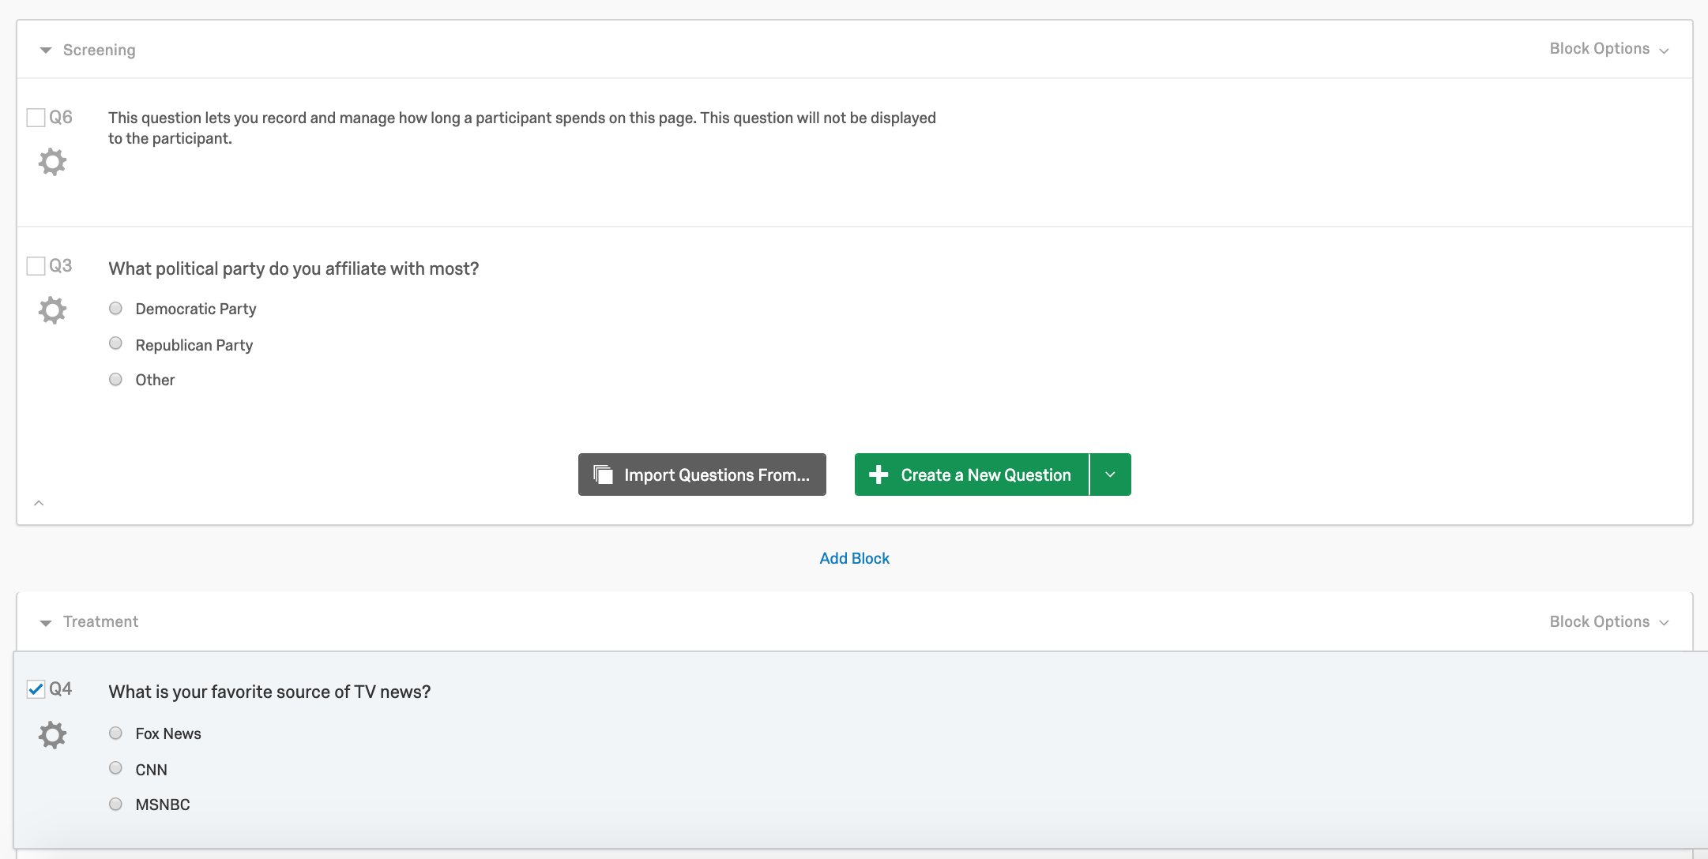
Qualtrics – Basic Structure
Question Blocks
A set of questions that are moved as a single unit
Add features like timing to an entire block
Good for moving around questions and duplicating entire blocks

Slide 10
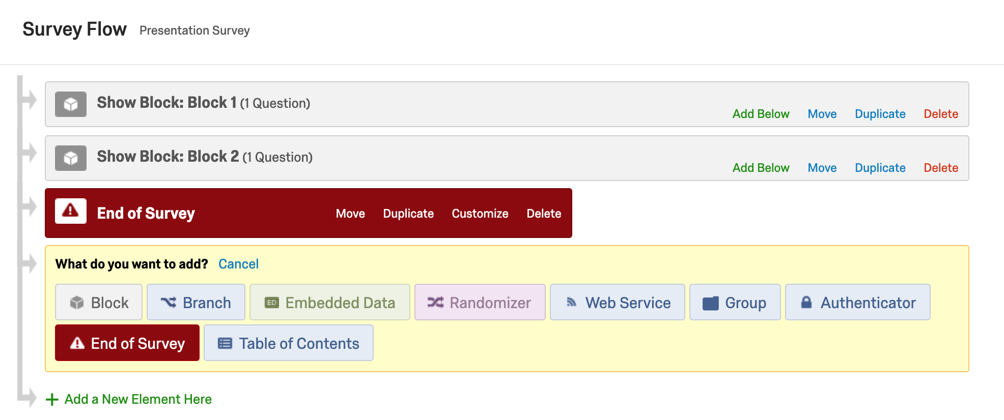
Qualtrics – Survey Flow

Slide 11
Qualtrics – Survey Flow
Good for keeping experiment structure organized
(Screening, Treatment, Control)
Branch Logic
Present questions conditionally (if age < 40, ask this…)
Custom survey ends
Randomization
Can randomize subjects’ treatment groups
Can put randomizers within randomizers
Allows subjects to get a random sample from question bank

Slide 12
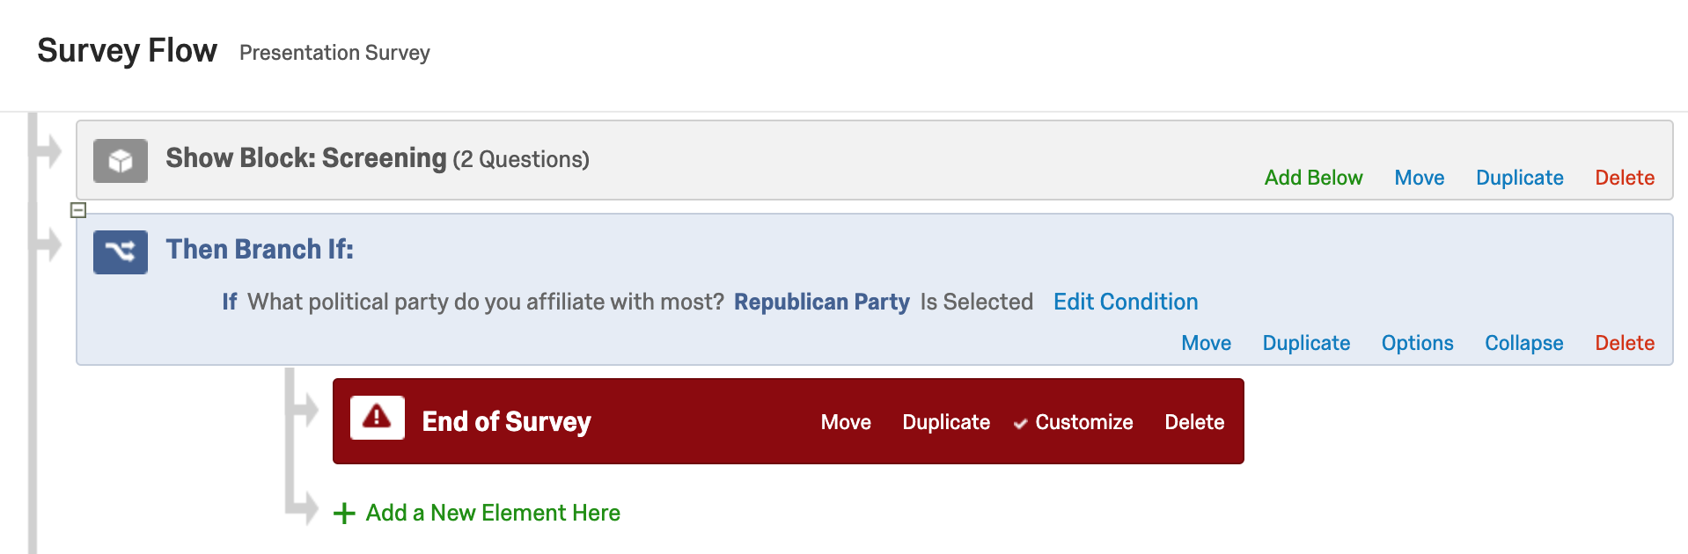
Qualtrics – Survey Flow (Screening)

Slide 13
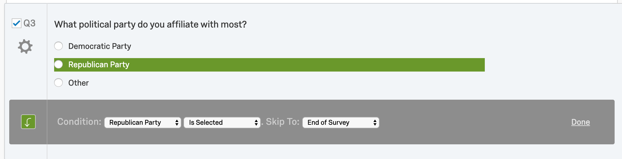
Qualtrics – Survey Flow (Screening)

Slide 14
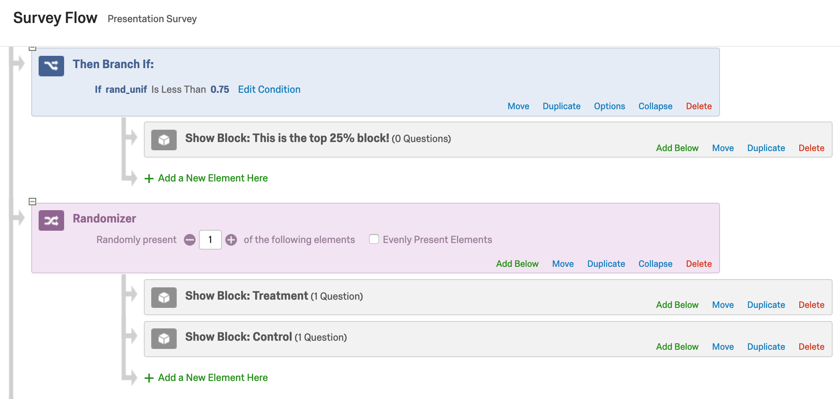
Qualtrics – Survey Flow (cont.)

Slide 15
Qualtrics – Survey Flow Demo

Slide 16
Qualtrics – Embedded Data
Data that is created or “set” at any point during the survey
A randomly generated number
Treatment number
Survey ID to keep track of subjects (more on this later with MTurk)
A number to create a probability distribution for questions
A value (numeric or otherwise) that is set and inserted into a future question
Can be pulled from web or set with JavaScript (more later)

Slide 17
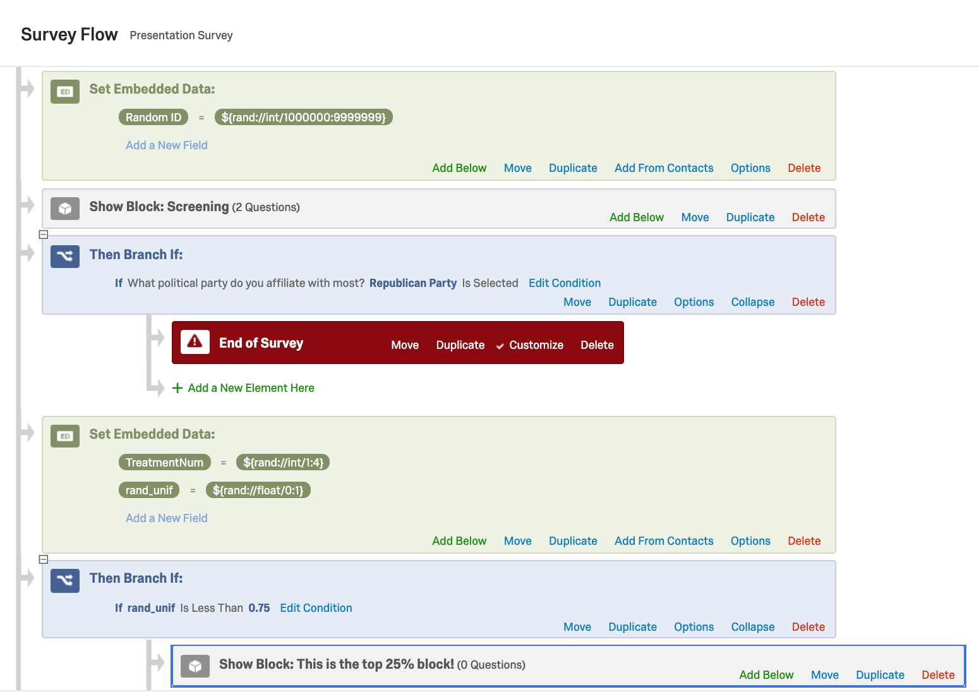
Qualtrics – Embedded Data

Slide 18
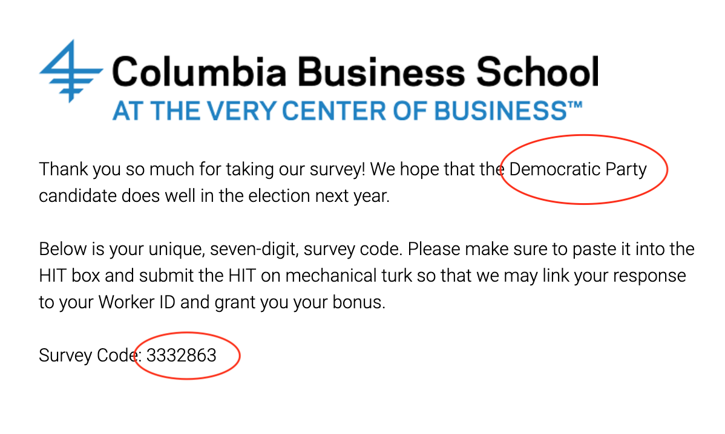
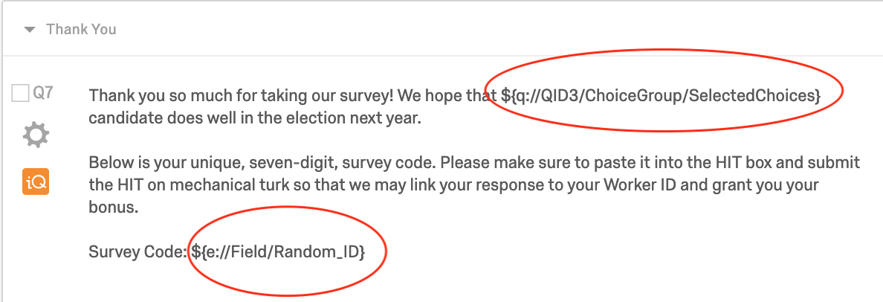
Qualtrics – Embedded Data/Piped Text

Slide 19
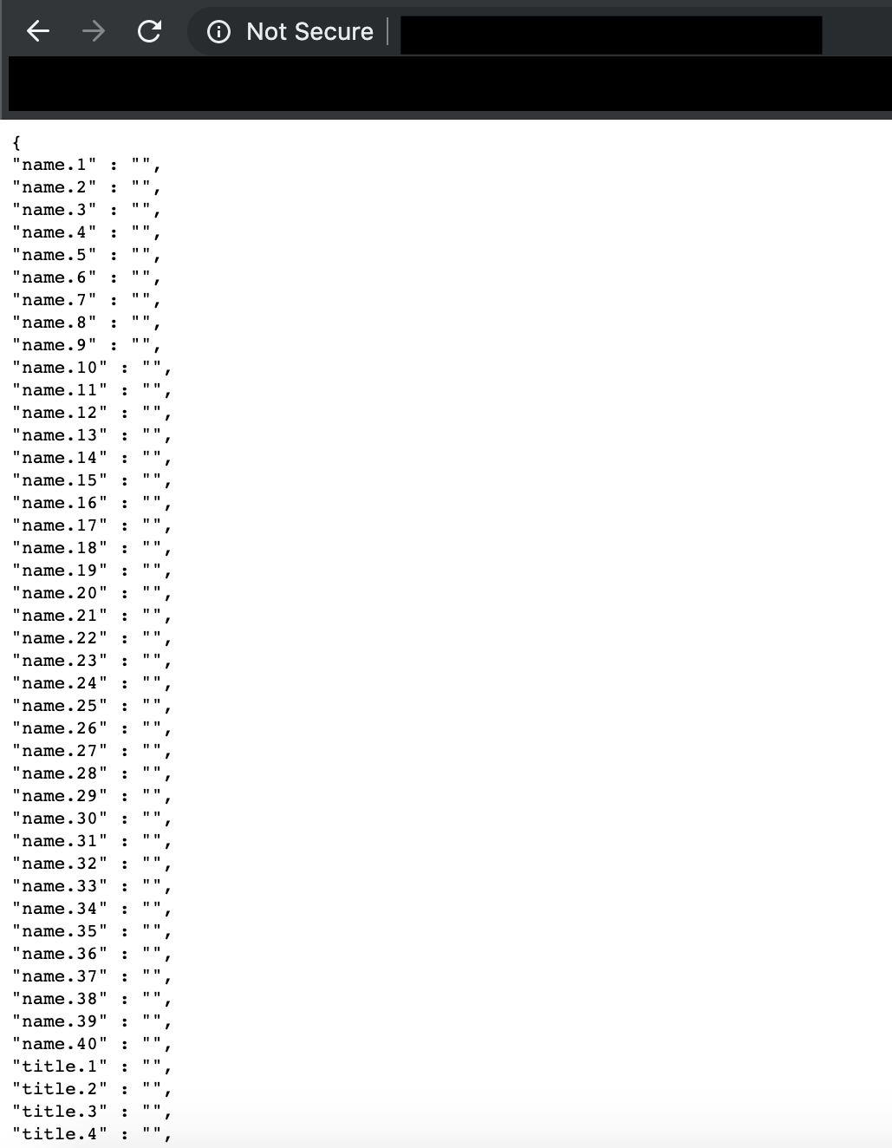
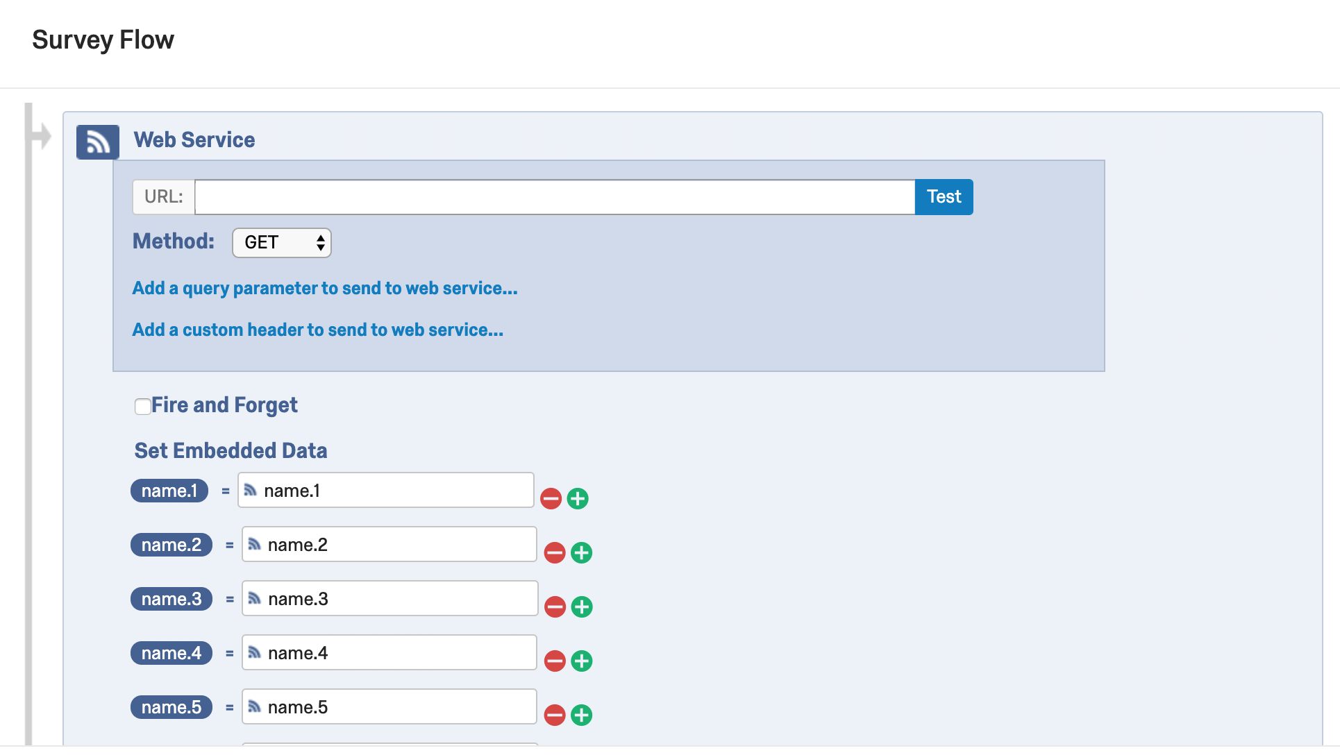
Qualtrics – Web Elements
Can import data and automatically set to Embedded Data from websites.

Slide 20
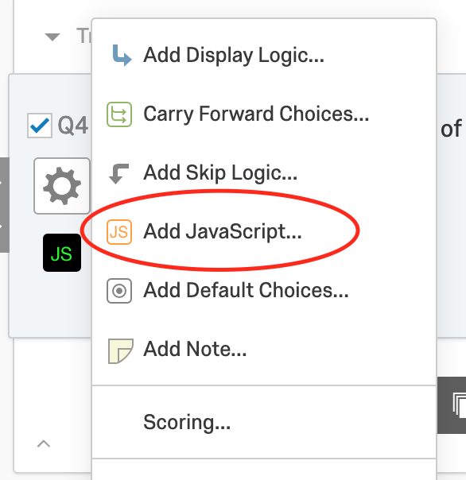
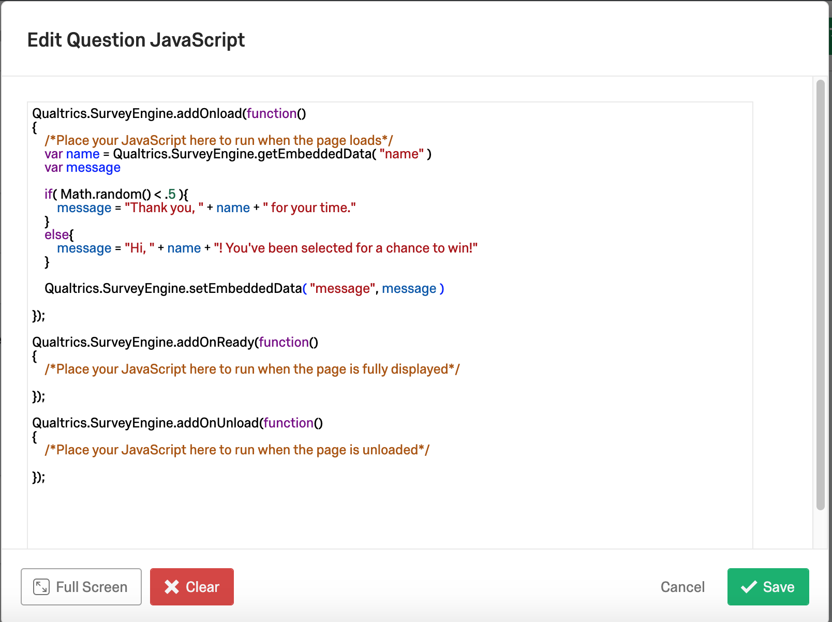
Qualtrics – JavaScript
JavaScript can help when datasets get larger or the experiment gets more complicated

Slide 21
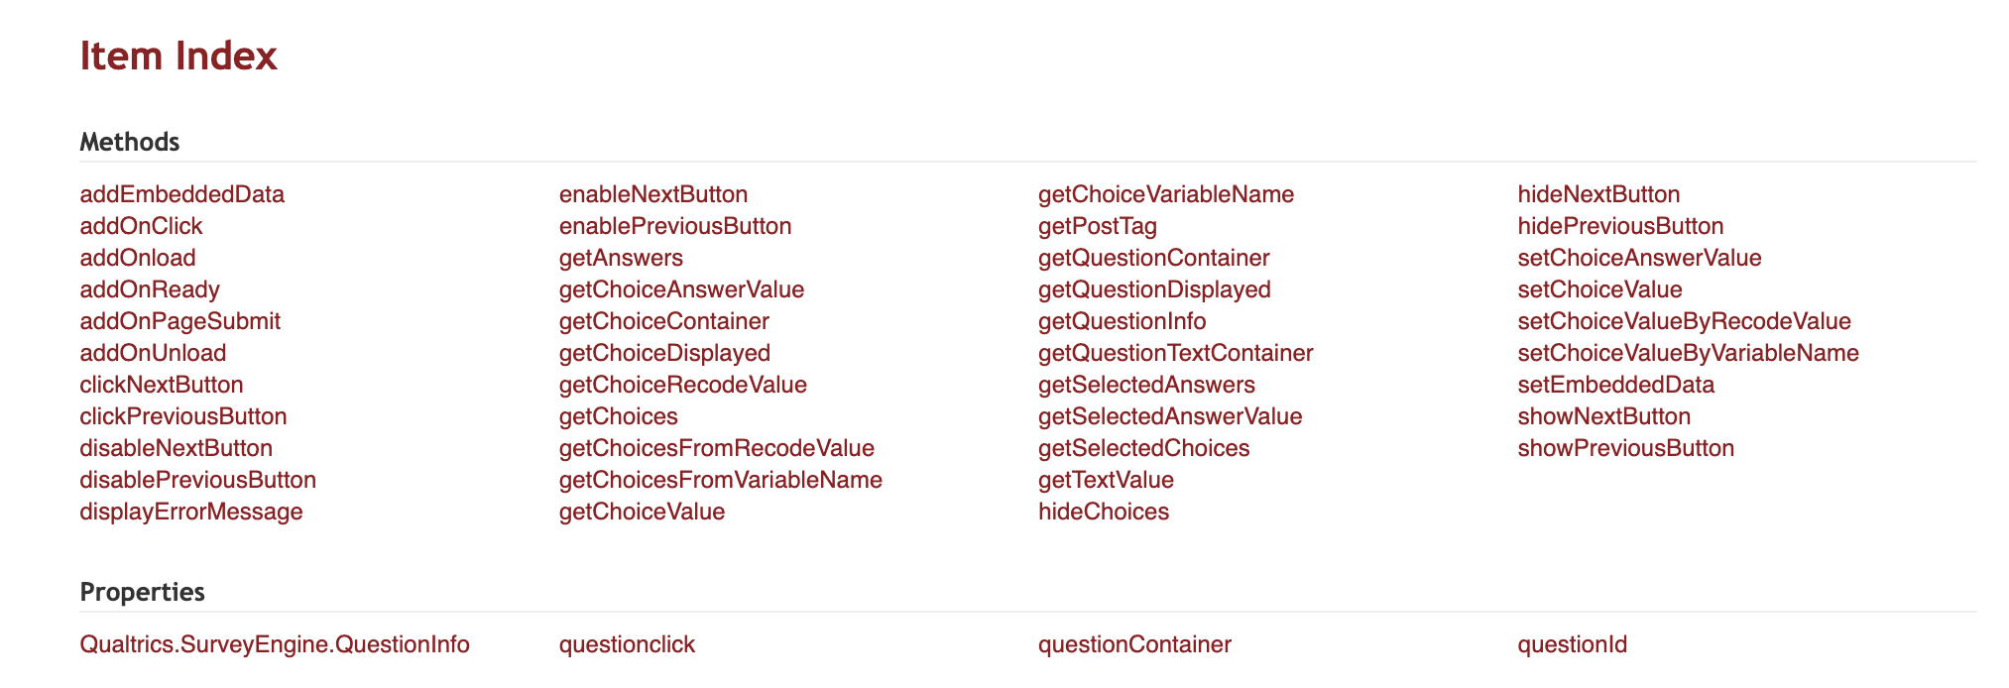
Qualtrics – JavaScript
JavaScript can help when datasets get larger or the experiment gets more complicated
Pro Tip: Need to run JavaScript the block before if setting embedded data that will be used immediately
https://s.qualtrics.com/WRAPI/QuestionAPI/classes/Qualtrics%20JavaScript%20Question%20API.html

Slide 22
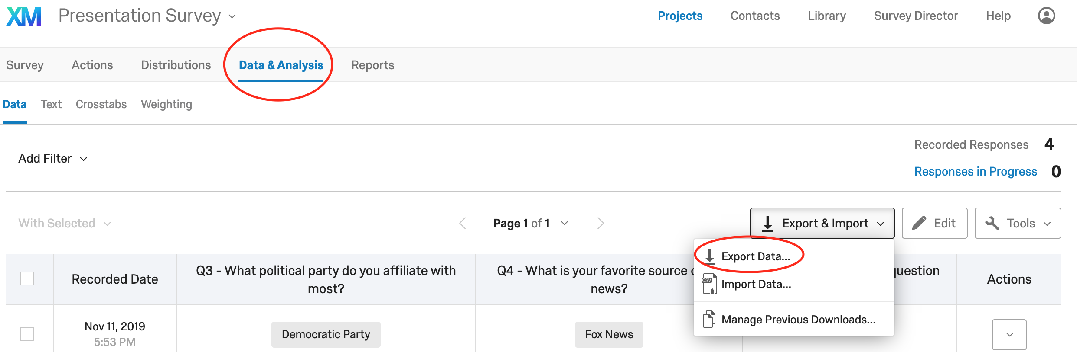
Qualtrics – Getting Your Data
Download the raw data as a CSV file

Slide 23
Qualtrics – Getting Your Data
Pro Tip: Under “More Options” you can
Turn off .zip download (annoying when you’re doing a lot of downloading)
Turn on/off viewing order for surveys with any randomness in order

Slide 24
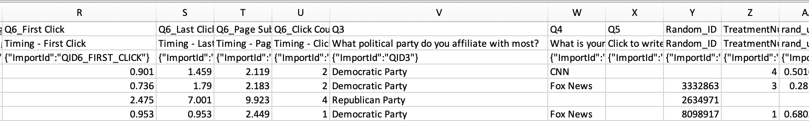
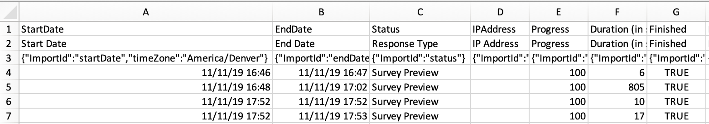
Qualtrics – Getting Your Data
All answers, embedded data, meta data (can be a good number of columns)

Slide 25
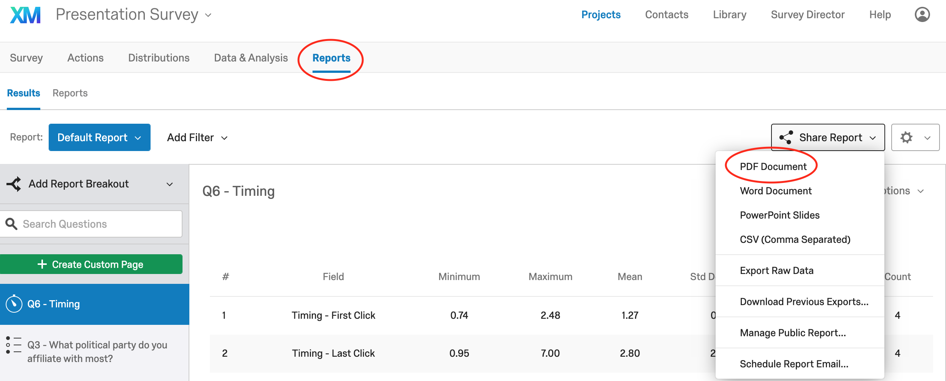
Qualtrics – Getting Your Data
Can also use Qualtrics’ “Reports” Feature

Slide 26
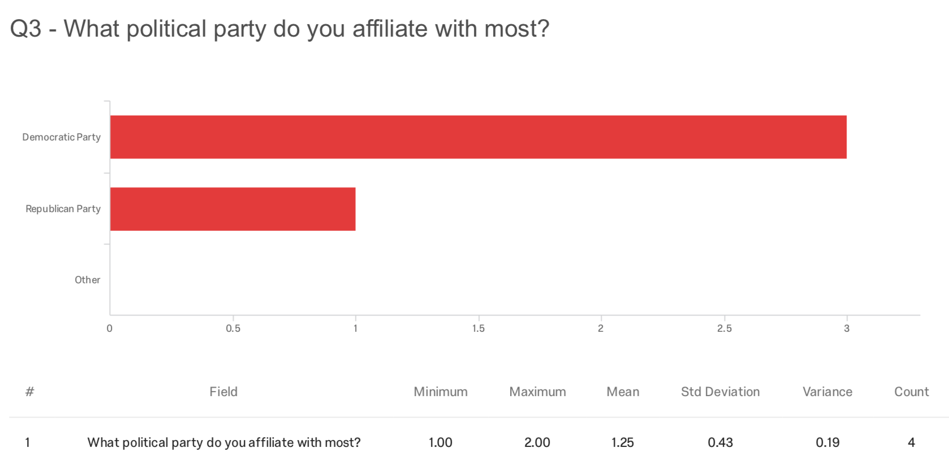
Qualtrics – Getting Your Data
Reports can be nice visually
Can see the survey questions
Default graphs (can change/add more)
Not too efficient for large projects with a lot of data
Less freedom than downloading raw data into CSV

Slide 27
Qualtrics – Getting Your Data Demo

Slide 28
Qualtrics – Design
Paid accounts have decent flexibility in terms of aesthetics
Can remove logos
Maybe you think having “Columbia” on every page will bias participants
Can choose from a few themes
Add a progress bar
Custom CSS

Slide 29
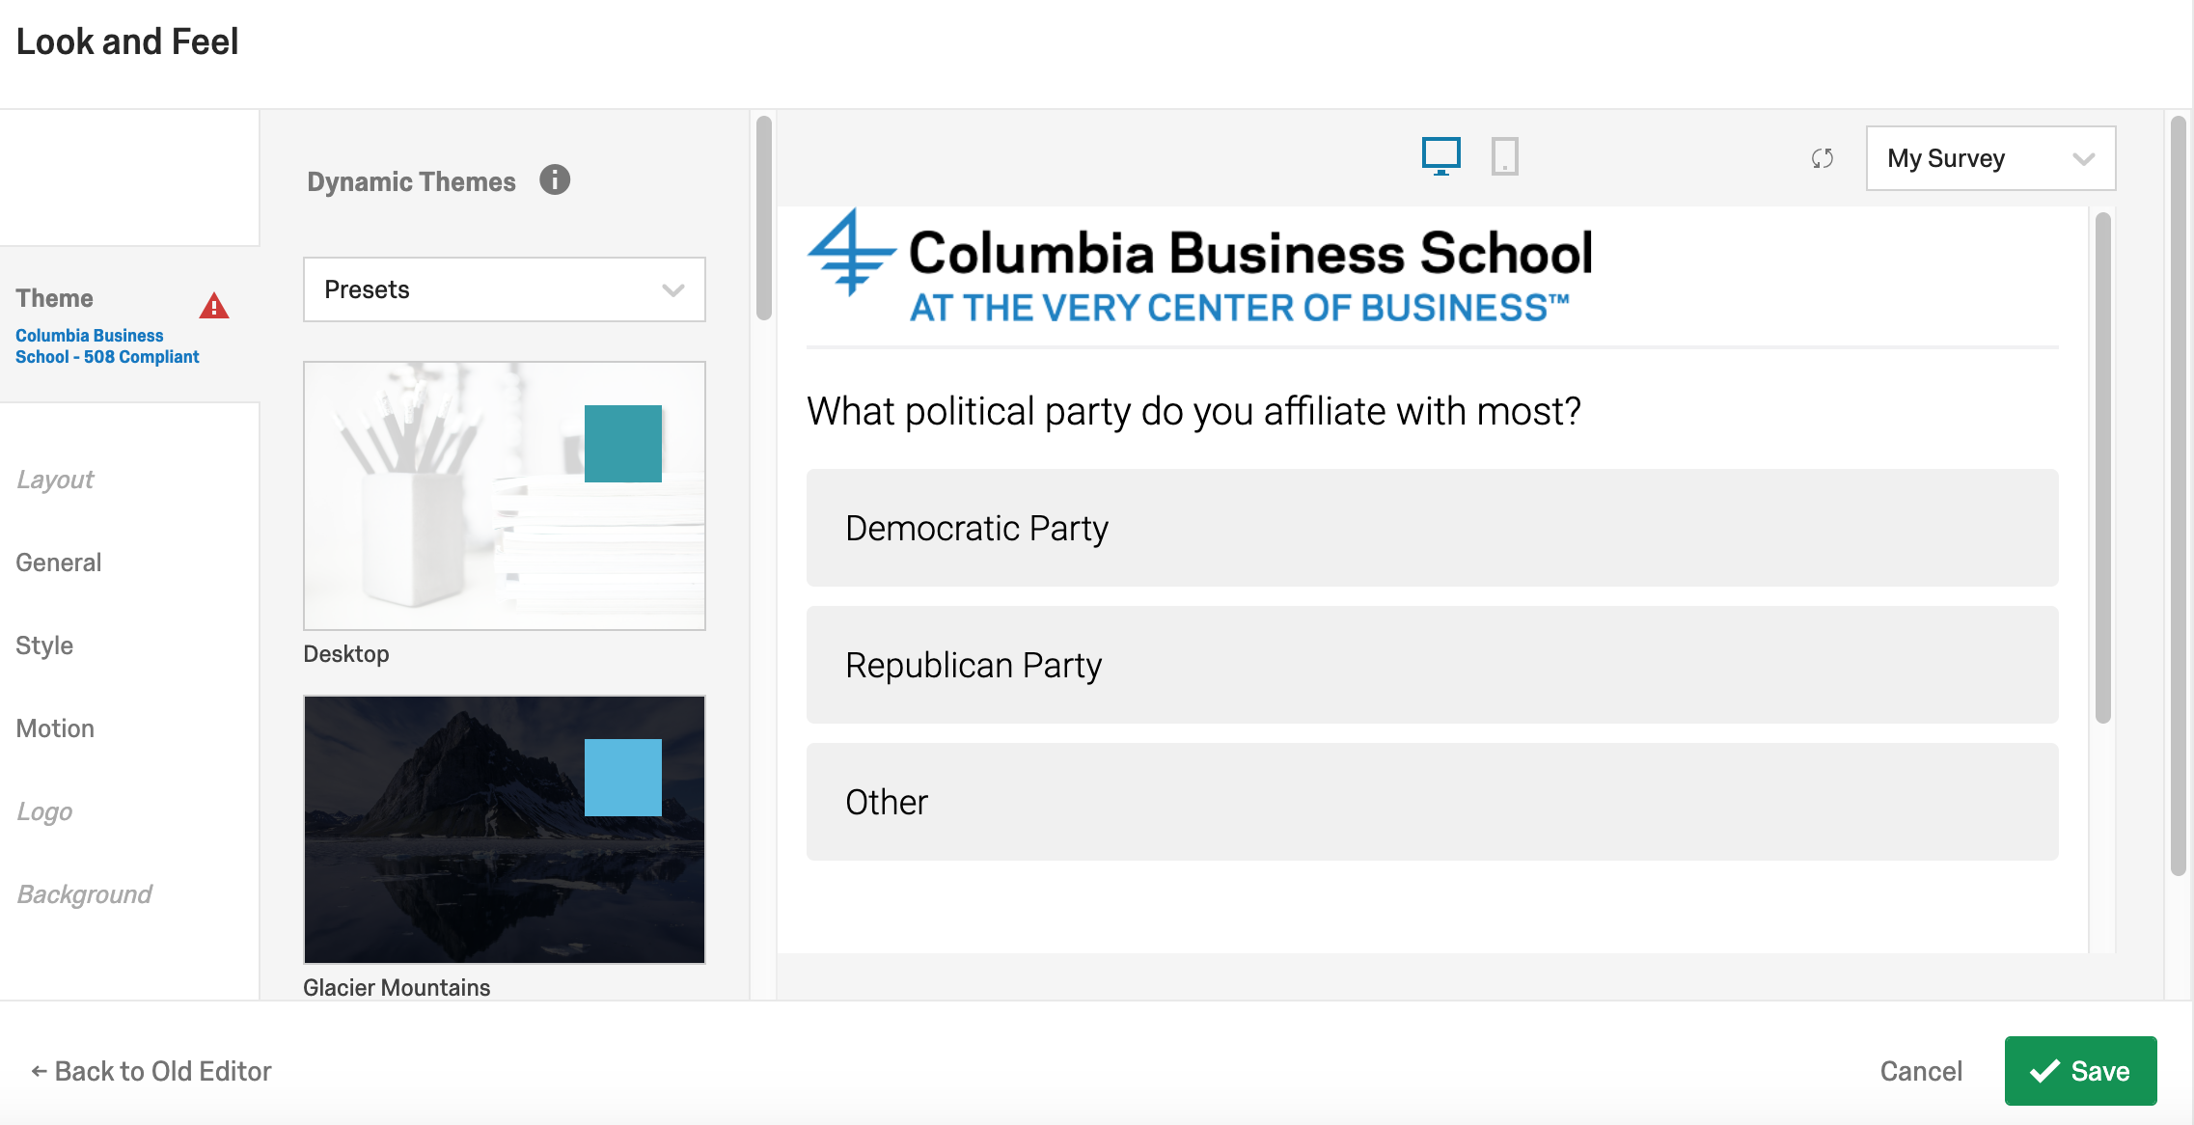
Qualtrics – Design

Slide 30
Qualtrics – Questions?!

Slide 31
Amazon Mechanical Turk
“Artificial artificial intelligence”

Slide 32
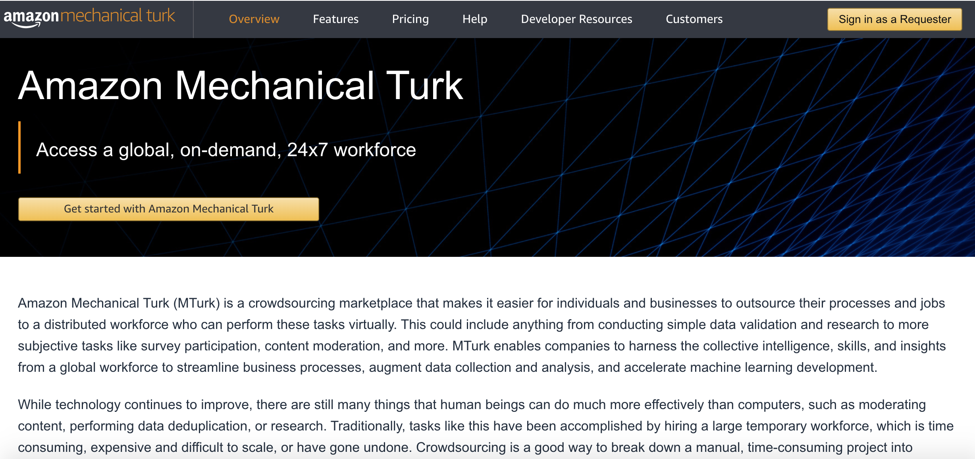
Amazon Mechanical Turk – What is It?

Slide 33
Amazon Mechanical Turk – What is It?
“MTurk”
Marketplace for work/tasks (more than 100K workers, more than 2K active)
Outsource computer labor to humans
Named after 18th century, “The Turk,” a chess robot that was actually controlled by a chess master
Used largely to create labeled data for machine learning
Tasks range from several seconds (identify photo) to hour-long surveys (maybe yours!)
Compensation ranges from $0.01/task to above minimum wage
Open to almost anyone with an Amazon account
Not really regulated
https://www.mturk.com/worker/help

Slide 34
MTurk – Vocabulary
Workers and Requesters
Human Intelligence Tasks, or “HITs”
Reward (Show-Up/Completion Fee)
Baseline amount being offered for completion of a task
Bonus
Additional compensation being offered based on performance
Payment can be primarily based on bonus
Batch
Requester creates a batch of HITs

Slide 35
MTurk – Low Wages, High Fees
Pay can be as low as $0.01/task
Amazon takes (high) fees on everything
20% on all rewards and bonuses
Additional 20% on batches with more than 10 assignments (i.e. almost all batches)
Additional fees for advanced worker restriction
Research shows median wage ~$2/hour
4% of workers making more than $7.25/hour
Average requester pays $11/hour but posts far less work
https://requester.mturk.com/pricing
A Data-Driven Analysis of Workers' Earnings on Amazon Mechanical Turk (2017)

Slide 36
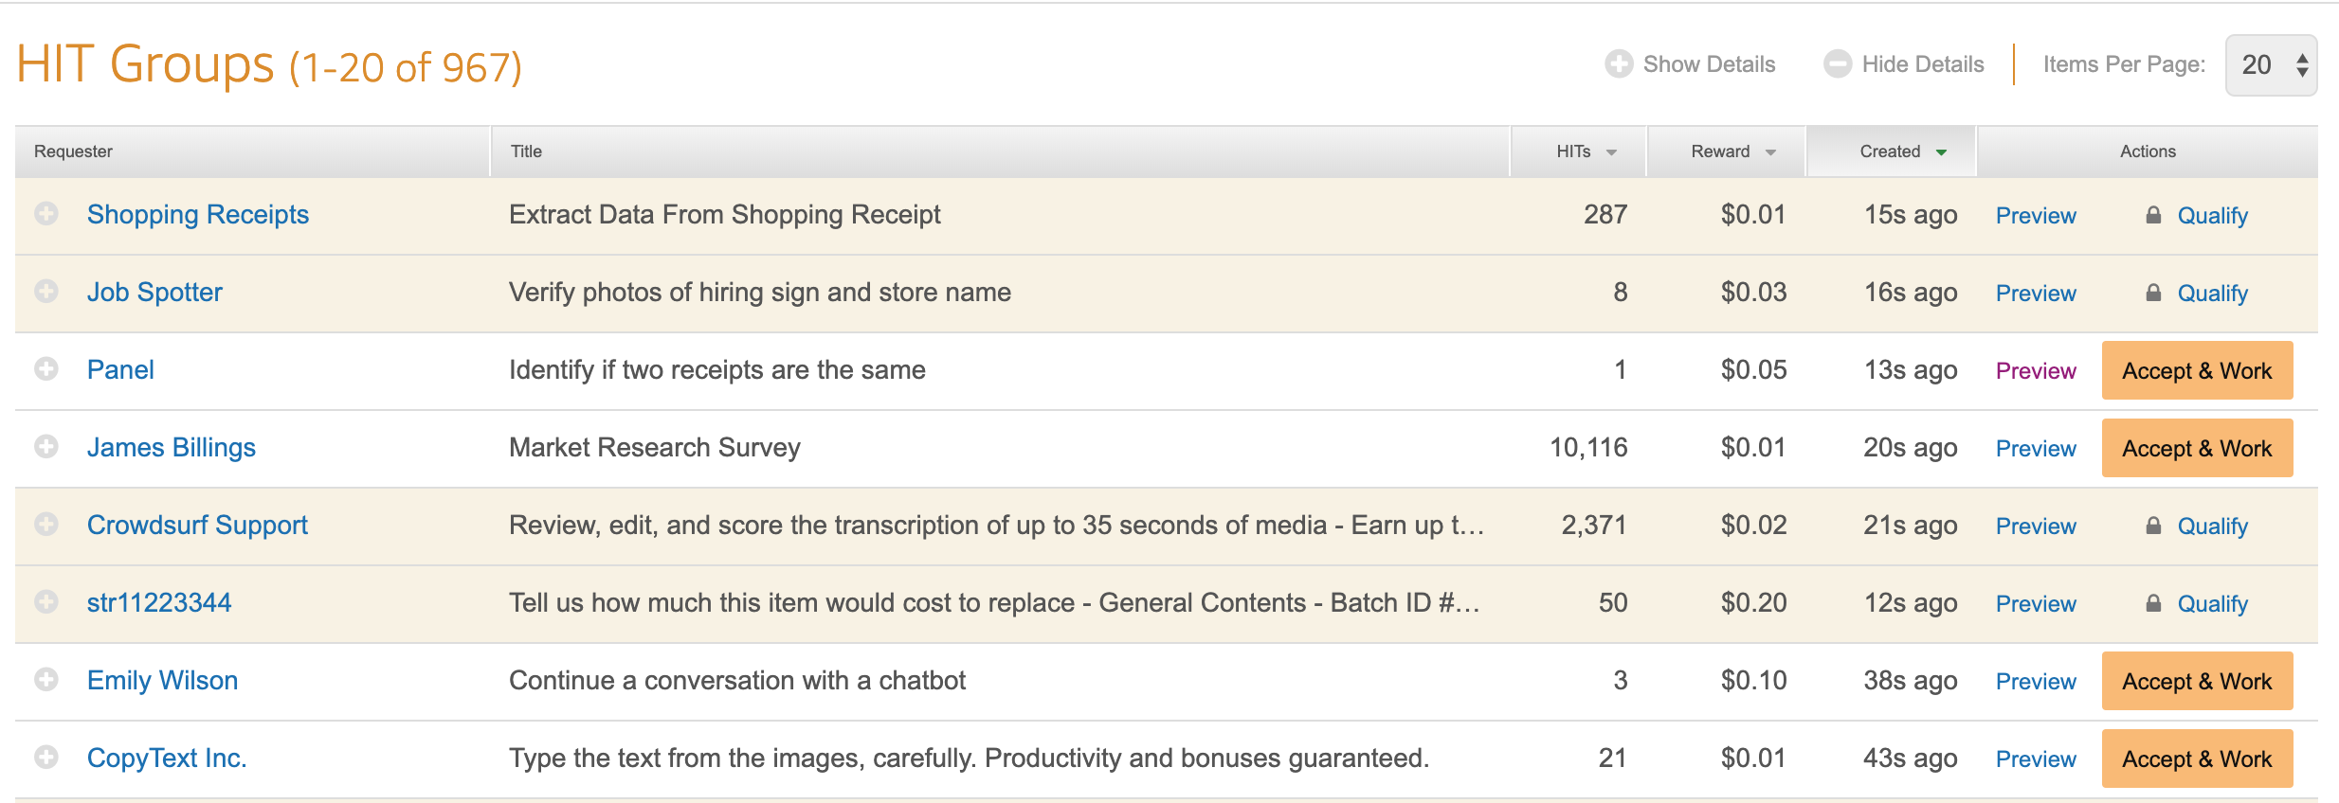
MTurk – Worker View

Slide 37
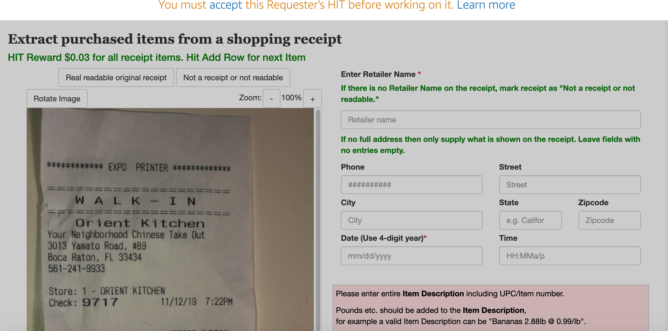
MTurk – Example HIT

Slide 38
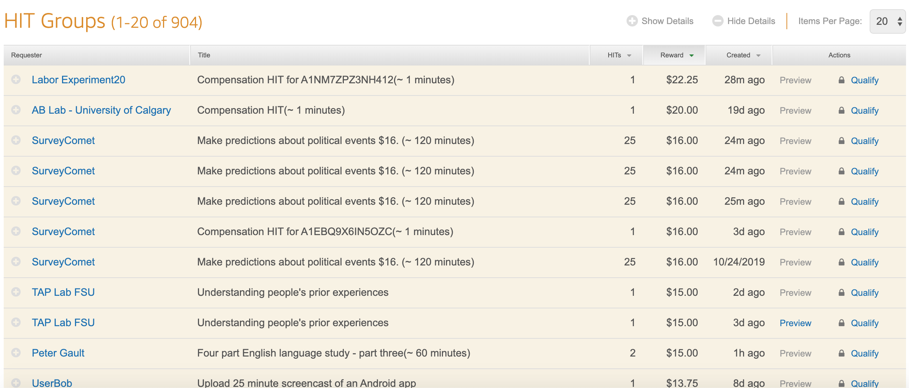
MTurk – Worker View

Slide 39
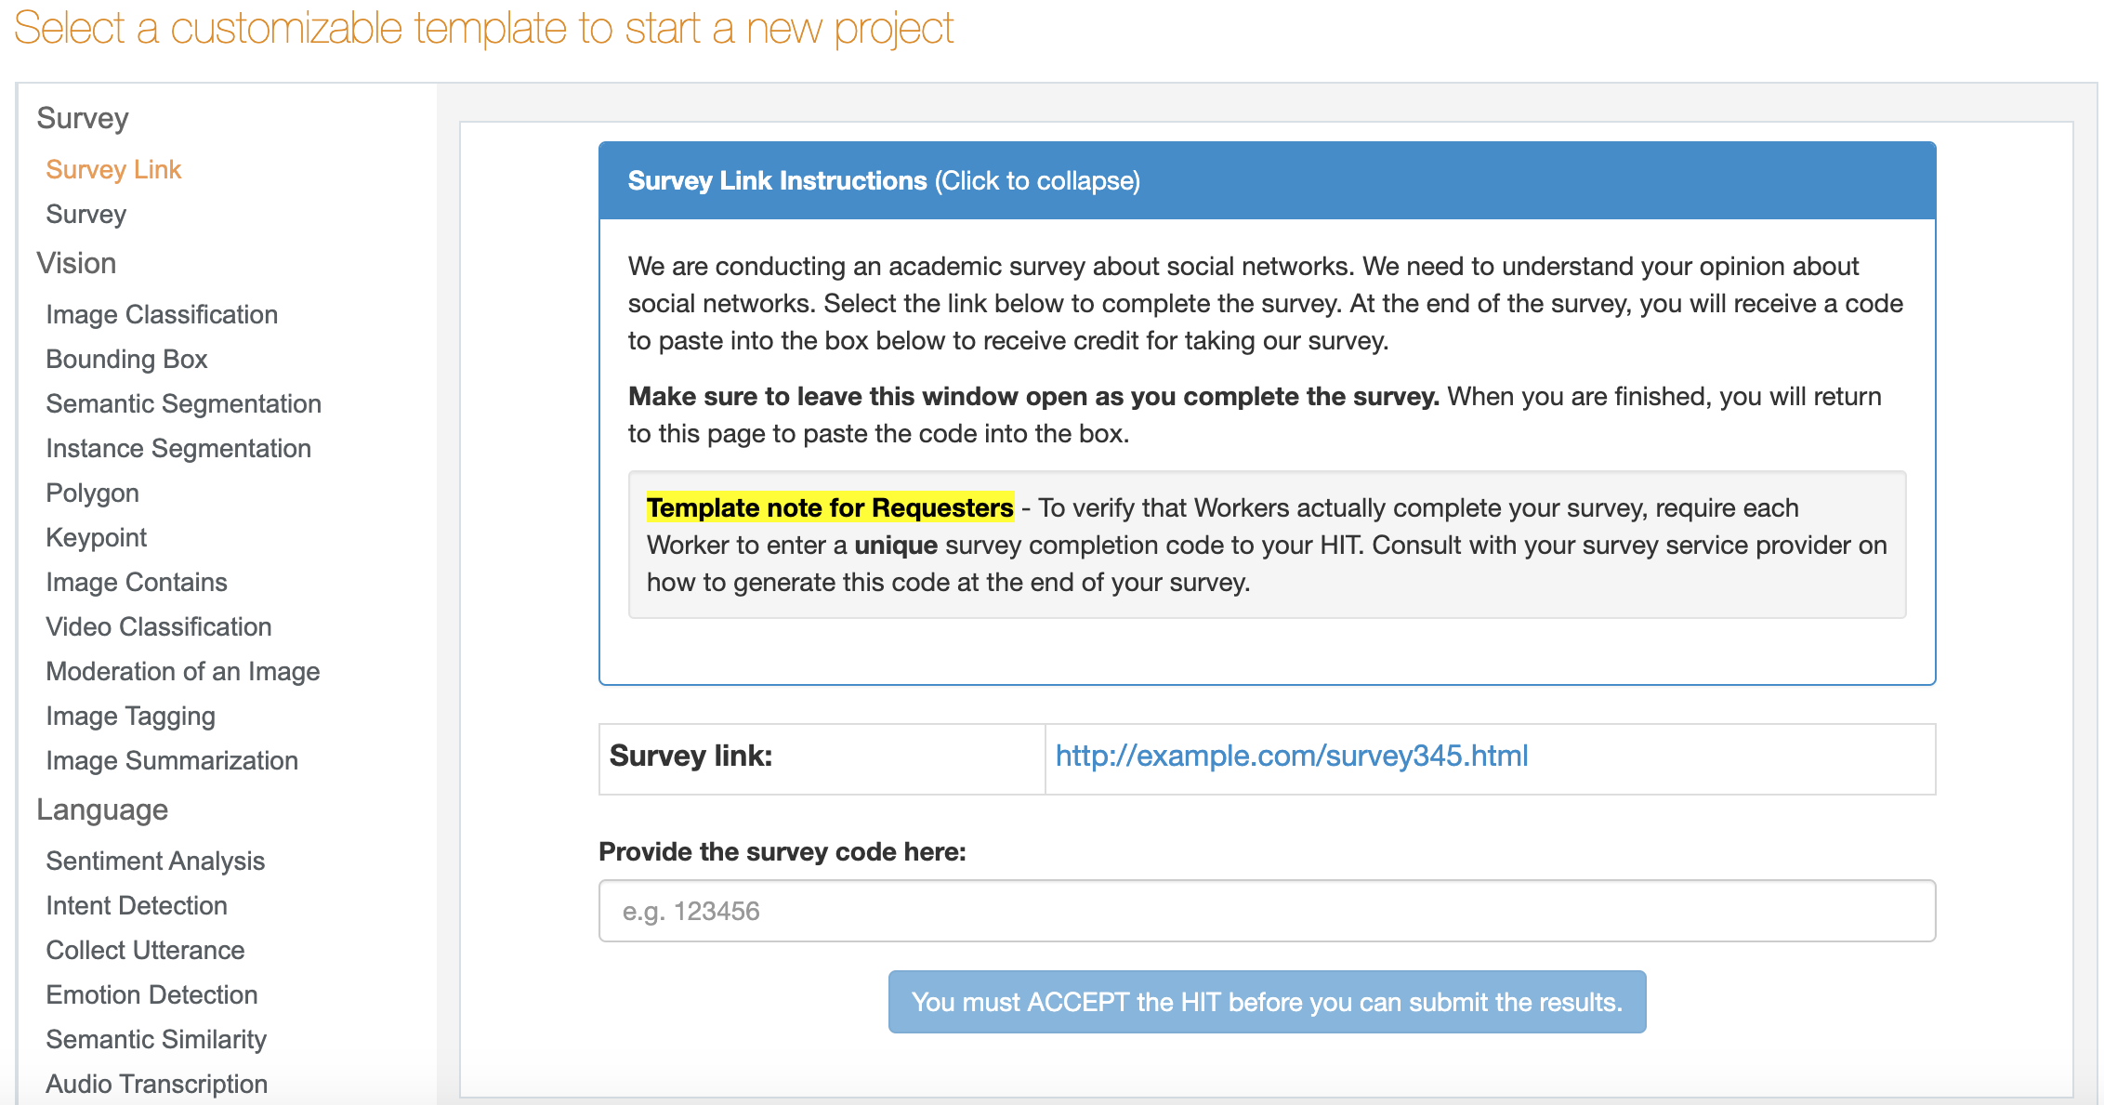
MTurk – Creating a Batch

Slide 40
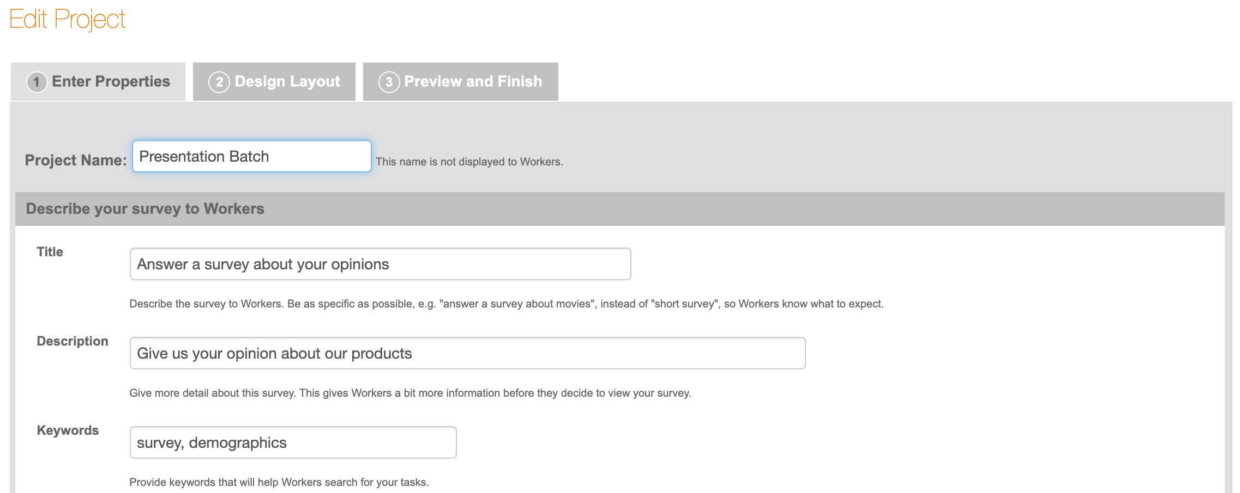
MTurk – Creating a Batch

Slide 41
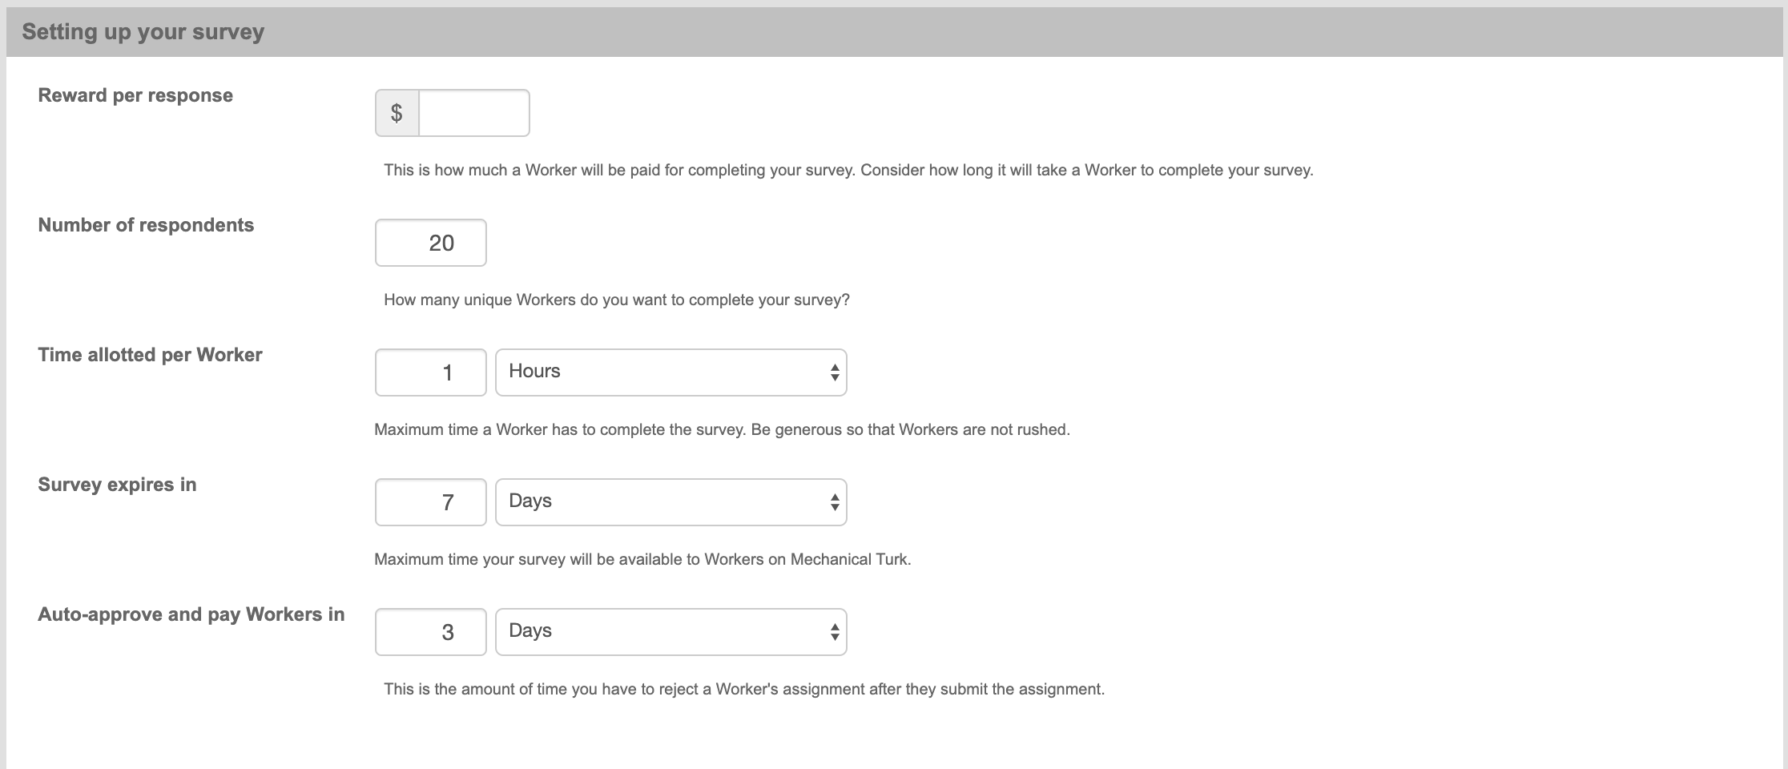
MTurk – Creating a Batch

Slide 42
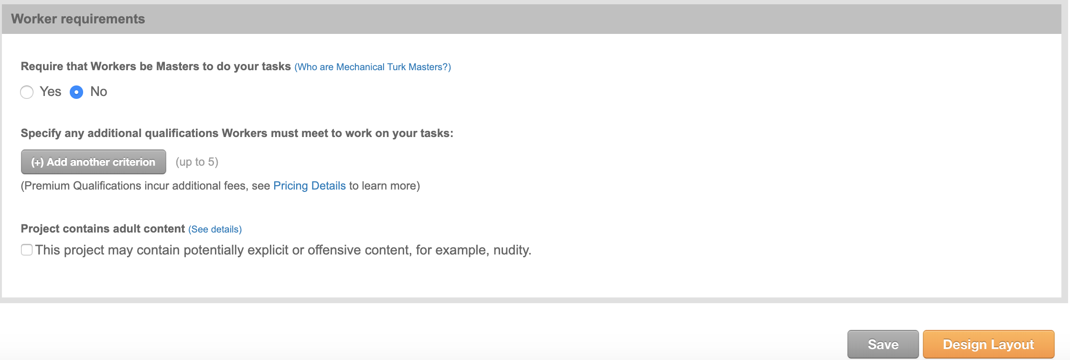
MTurk – Creating a Batch

Slide 43
MTurk – Who Takes My Survey?
Anyone with an Amazon account is eligible by default
May be machines trying to complete your HIT
Can restrict who takes your survey
Only those in US
No one who has taken one of my surveys before
Only workers with a high HIT Approval Percentage (important)
Advanced qualifications and restrictions (expensive)
MTurk Masters (additional 5%)
Restrict by political affiliation ($0.40/worker)
https://requester.mturk.com/pricing

Slide 44
MTurk – Who Takes My Survey?
Workers are quick
Can get hundreds of responses in a few hours
Depends on your pay rate, survey, etc.
Tradeoff between quality and speed
Ideally you want to restrict to workers with >99% HIT approval
Noticeable difference between >95% and >99% (>97% seems okay)
Note that some people may be bad subjects (careless, machines)
Incentive good performance (bonuses for getting certain questions right)
Add questions to see if people are paying attention

Slide 45
MTurk – Who Takes My Survey?
Workers qualifications
Existing ones include HIT Approval Percentage
Can create your own
Label for previous workers will let you exclude people who have taken your survey before
Can create any label to filter towards or against certain workers you’ve had
https://blog.mturk.com/tutorial-understanding-requirements-and-qualifications-99a26069fba2

Slide 46
MTurk – Demographics
Primarily workers in US and India
Fairly even gender split
Tend to be younger
Fairly even married/single split
http://www.ipeirotis.com/wp-content/uploads/2017/12/wsdmf074-difallahA.pdf
http://demographics.mturk-tracker.com

Slide 47
MTurk – Creating a Batch Demo

Slide 48
MTurk – Best Practices
Give a decent wage
Some researchers argue that you should pay what you would in a lab
Pay workers in a timely fashion
Auto-approval feature
Workers can see how long you take to pay on average
Be mindful that workers have communities
reddit.com/r/mturk
Don’t want to be a requester that people are speaking badly about
Also means that workers will quickly jump towards good opportunities

Slide 49
MTurk – Managing Results
Batch progress/results
Approve workers
Pay out reward (bonus is separate)
Update worker qualifications

Slide 50
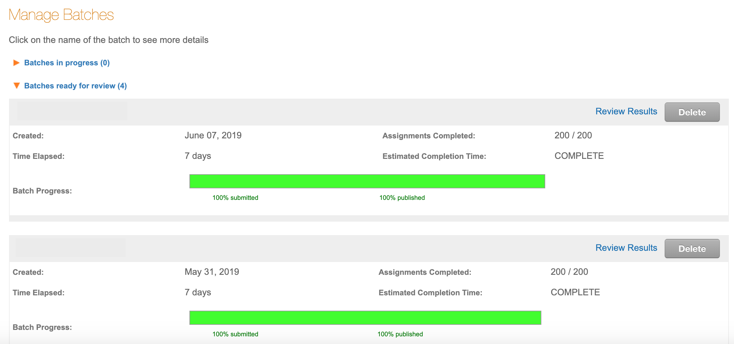
MTurk – Managing Results

Slide 51
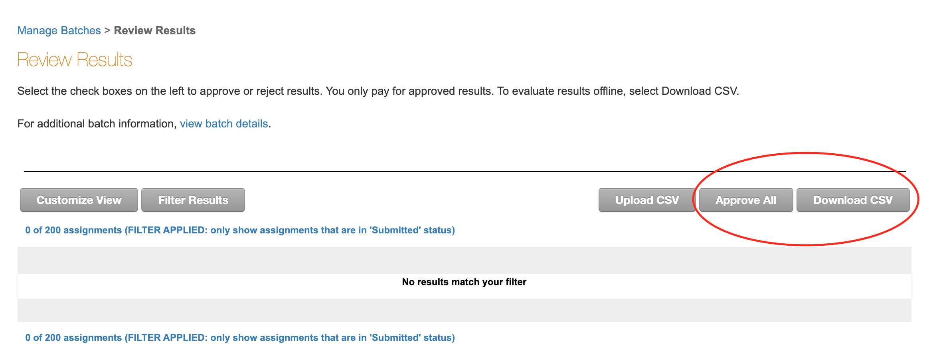
MTurk – Managing Results

Slide 52
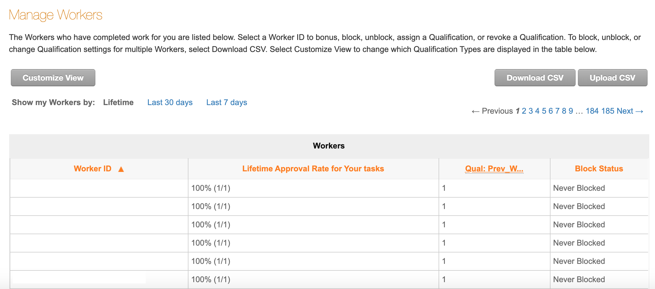
MTurk – Managing Workers

Slide 53
MTurk – Managing Workers
Might have to update worker qualifications between every batch
For example, if you don’t want people taking your survey twice
Paying out bonuses is done individually if done on the website
Use MTurk developer to pay out bonuses in bulk

Slide 54
MTurk – Paying Bonuses
Recall that in Qualtrics we gave everyone a random ID

Slide 55
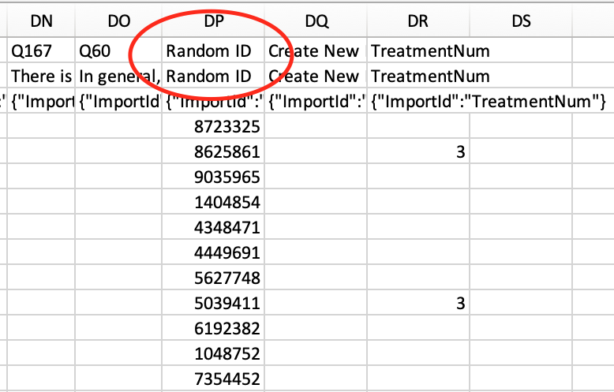
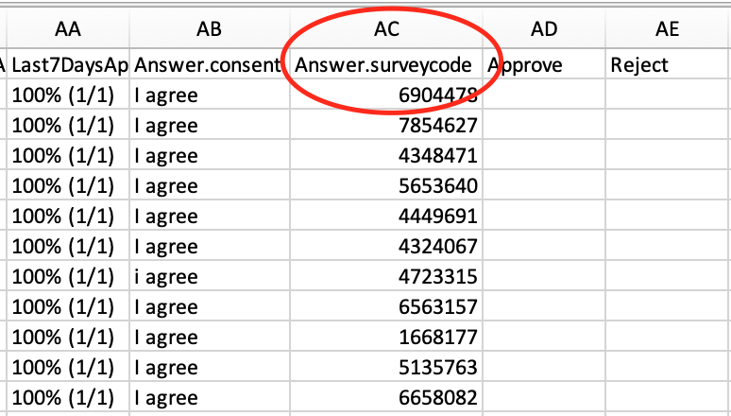
MTurk – Paying Bonuses
Qualtrics
MTurk

Slide 56
MTurk – Paying Bonuses
Once you’ve downloaded both the Qualtrics results and MTurk results, have to link workers to their Random ID
Excel VLOOKUP or INDEX/MATCH
Stata merge
R merge or which( )

Slide 57
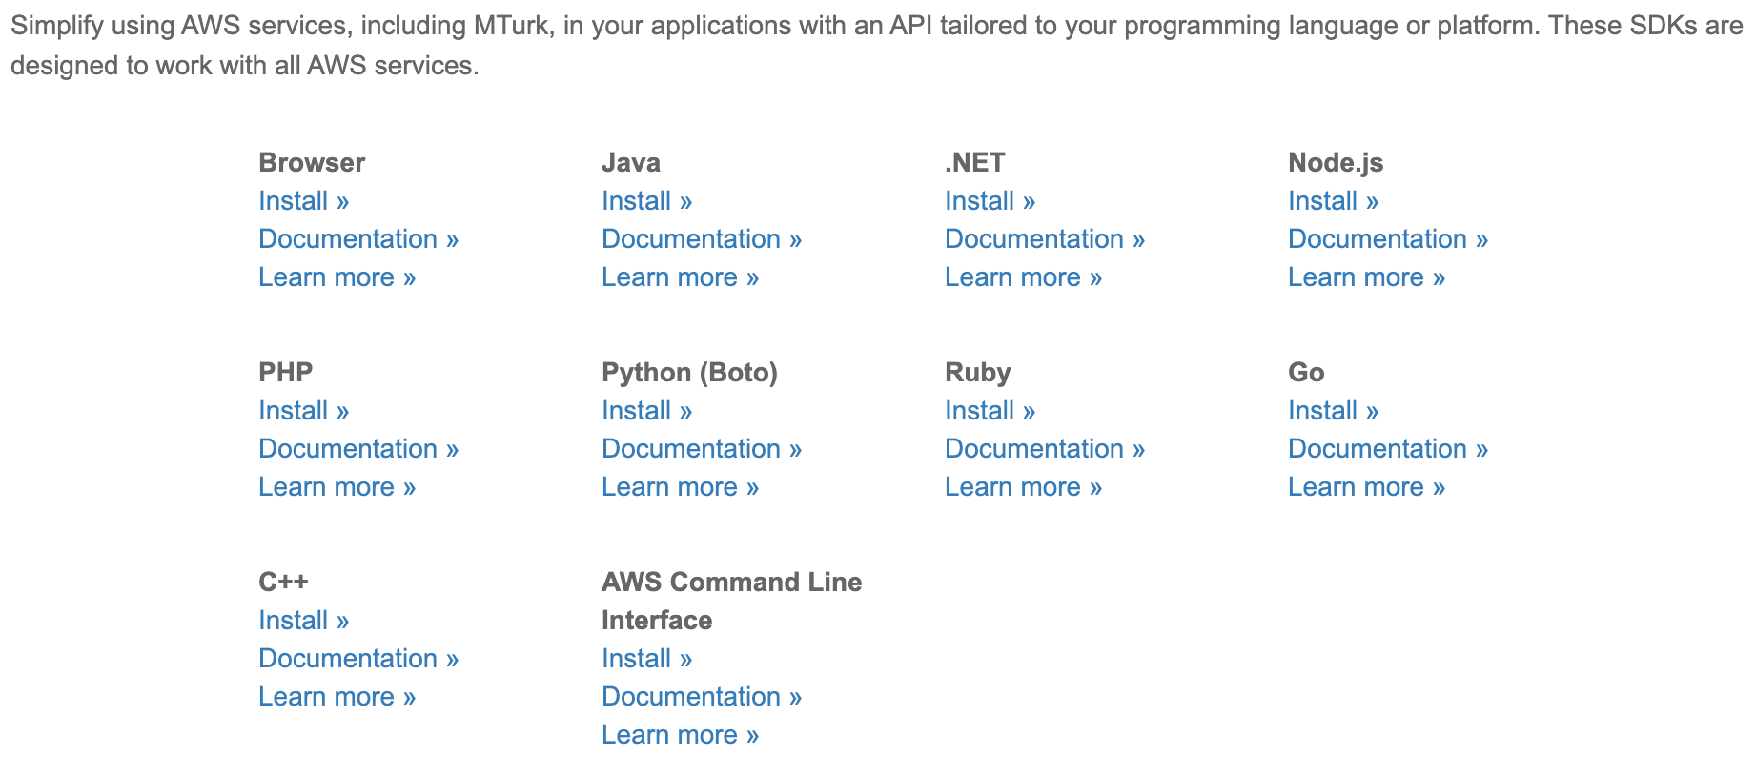
MTurk – Developer
Use to avoid paying out bonuses individually
Requires Amazon Web Services (AWS) account
Free, easy to set up
Can use a variety of languages
I use the command line (Terminal)
https://requester.mturk.com/developer

Slide 58
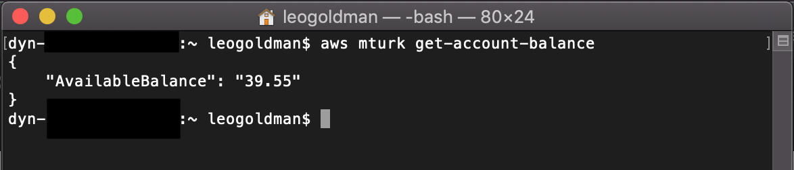
MTurk – Developer
Once you connect your AWS account, can do most things from Developer
Only really needed for paying bulk bonuses
Don’t need code to create a batch

Slide 59
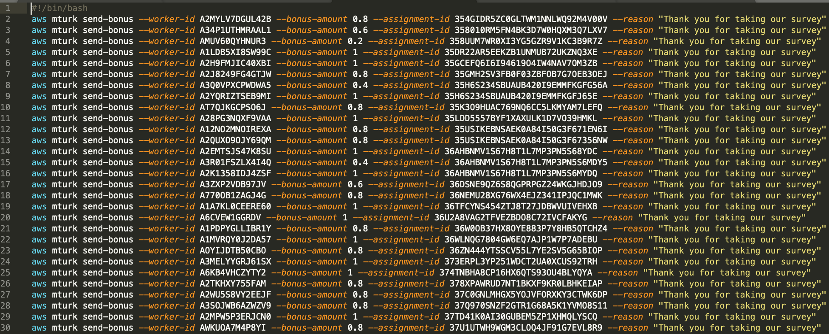
MTurk – Developer

Slide 60
MTurk – Questions?!

Slide 61
Thank You!
Come to CELSS consulting hours!
Fall 2019:
IAB 505 (the lab)
Mondays 6-8:30pm
Thursdays 10am-12:30pm

